Slide 1
Ongoing and Proposed Research in the Burns Bog Ecological Conservancy Area
Dr. June Skeeter Dr. Sara Knox

Slide 2
Introduction

Slide 3
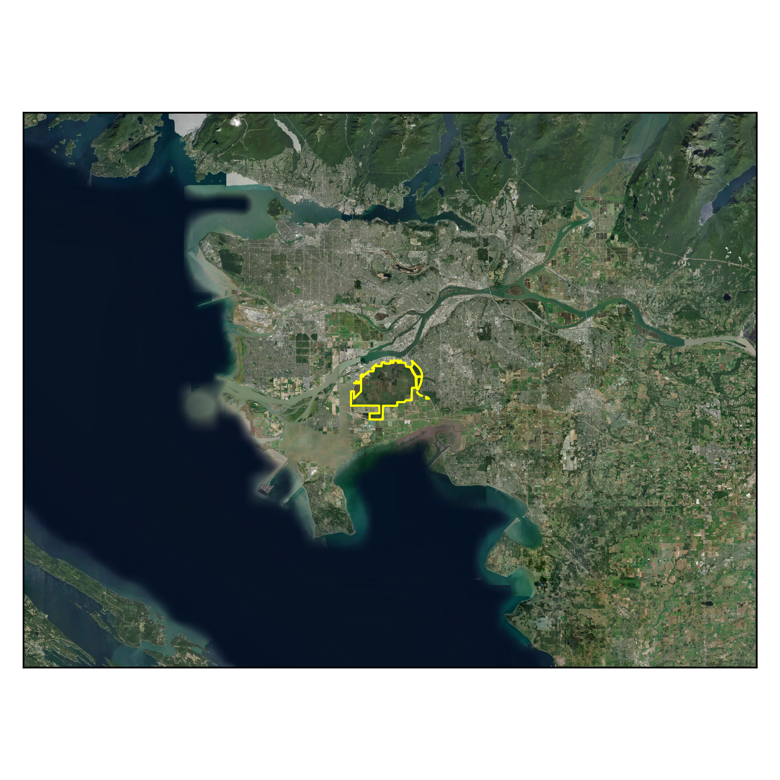
The Burn Bog Ecological Conservancy Area (BBECA) was established in 2004 to protect the remaining area of Burns Bog from development.
Decades of peat harvesting damaged the peatland ecosystem
Active and passive restoration strategies
Protects as unique raised peatland ecosystem
Largest bog on pacific coast
Near the southern boundary of conditions favorable climate conditions for peat accumulation

Slide 4
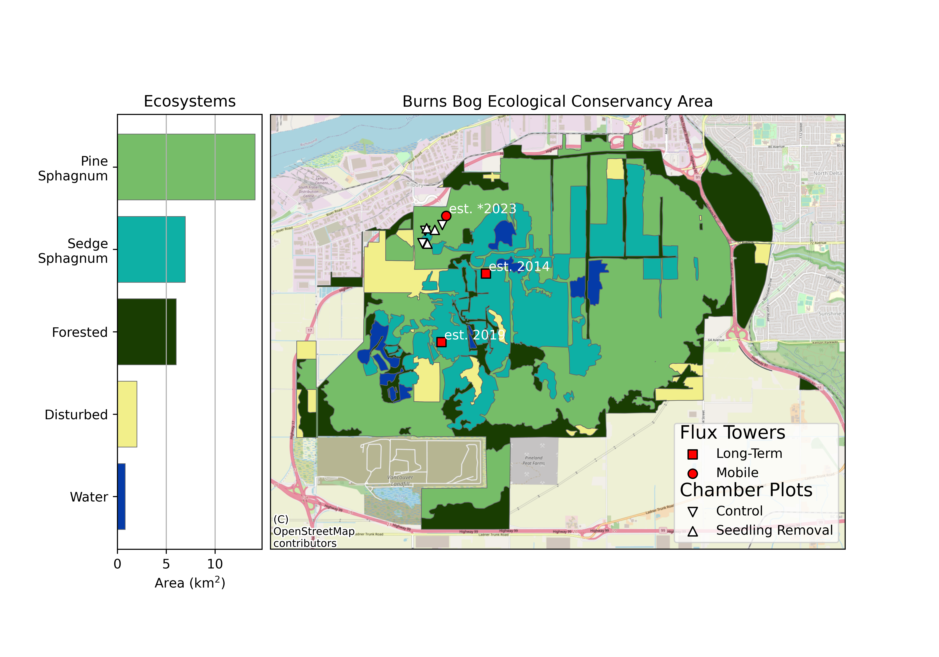
Ecosystems

Slide 5
Climate Change

Slide 6
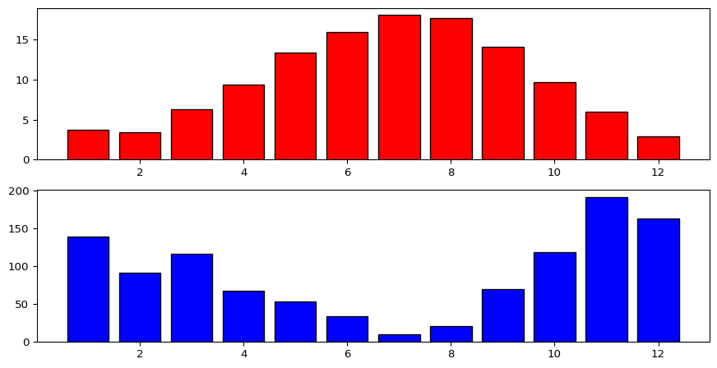
Climate change presents challenges to management:
Summer heatwaves and droughts
Decreased C uptake and increased C emission
Increase wildfire risk
Fires in the bog release C
Smoke events reduce C uptake
Intense winter precipitation
BBECA Climatology

Slide 7
Restoration Activities
Ditch Blocking Seedling Removal

Slide 8
Micromet Sites
Two flux towers
BB1 {Img}
BB2 {Img}
BBS {Img}

Slide 9
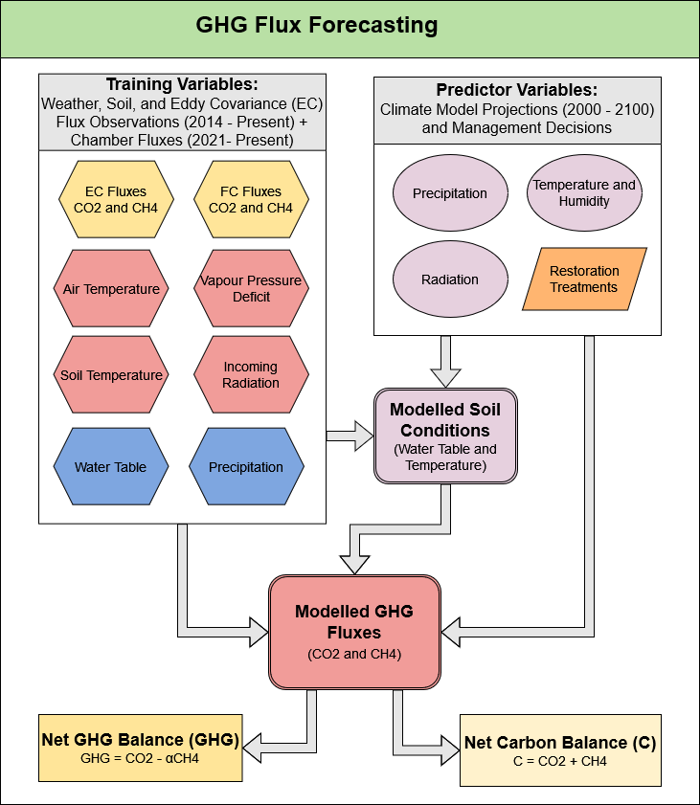
Modelling Fluxes
Developing a model to estimate potential future ranges of C fluxes for MetroVancouver

